Slide 1
mapping and map-based sequencing

Slide 2
Very simple example for mapping:
Restriction-digest-based mapping
mol. weight marker
EcoR1 & BamH1
EcoR1
BamH1
5000
pMFP
4000
3000
2000
How big is the plasmid (bp)?
Where are the restriction sites for the enzymes BamH1 and EcoR1?
1500
1000
500
200

Slide 3
Using restriction maps of fragments in plasmids
to generate map of original DNA sequence
EcoR1
BamH1
pMFP
~5000 bp
Nco1
EcoR1
pMSP
~5000 bp
Nco1
BamH1
EcoR1
BamH1
Xba1
Xba1
Bst1
Xba1
pMTP
~5000 bp
Xba1
Not1
BamH1
Xba1
Multiple copies of an original linear DNA sequence were broken into fragments and then cloned into plasmids (plasmid backbone in blue). You have generated restriction maps of your plasmids.
Can you generate a map of the original DNA sequence?

Slide 4
Sanger sequencing

Slide 5
Sanger Sequencing
Given the sequencing gel on the left, what is the sequence in 5’ to 3’ order?
How long would be a real Sanger sequence read?
What would be the error rate?
A
G
C
T

Slide 6
Using Sanger Sequencing to check the
success of a cloning experiment
A
You are trying to clone your favorite Gene (YFG) for protein expression (sequence see below). You finally have obtained a plasmid vector that might contain YFG?
Your Sanger sequencing reaction with the orange sequencing primer gives you the gel shown on the right.
What does the data tell you, did you clone YFG or some other random stretch of DNA?
If you want to continue sequencing what would be the sequence of the next sequencing primer (5’-3’)?
G
C
T
YFG ?
M P R L L S A G A L H E Y E E stp
YFG seq
5’-ATGCCTAGATTACTCAGCGCAGGTGCGCTCCATGAATATGAAGAGTGA-3’
3’-TACGGATCTAATGAGTCGCGTCCACGCGAGGTACTTATACTTCTCACT-5’

Slide 7
sequencing by synthesis & shot-gun sequencing

Slide 8
Assembly of a DNA sequence from short read sequencing data (easy example) (1)
TAGATGACCT
GACCTTCTAT
GAGGCATGGA
CGTTGGATAT
TCTATTCCCA
ACTACTAGAT
ATGGACGTTG
CTGGGACTAC
TCCCATAAGT
TAAGTGAGGC
Can you find the original sequence?
How long is the sequence?
What is the average coverage?
Is this a realistic example? Why?

Slide 9
Assembly of a DNA sequence from short read sequencing data: Example 2
TAGATGACCT
TTCTATTCC
GTTGCTAGTT
CCTTCTATTC
ACGTTGCTAG
TTGCTAGTTA
CTGGGACTAC
TTACTGGGAC
TCTATTCCC
GGGACTACT
ACTGGGACTA
GGACTACTAG
Can you find the original sequence?
How long is the sequence?
What is the average coverage?
Is average coverage a good indicator of data quality?
CTAGTTACTG

Slide 10
Assembly against a reference sequence: Distinguishing Single Nucleotide Polymorphisms (SNPs) from sequencing errors
Reference Sequence
GTTTCAACCACGTTGCTAGTTACTGGGACTACTAGATGACCTTCTATTGTATCAACCT
Sequencing data from individual
GTTTCAACCACGTT
TACTGGGACTACTGG
TTCAACCACGTTGCTAG
ACTGGGACTACTGGAT
ATTGTATCAACCT
GCCACGCTGCTAGT
TAGGACTAATGGA
CTATTGTAGCAACC
ACCACGTTGCTAGT
ACTGGGACTACTG
TTATATTGTATCA
CGTTGCTAGTTACTGGG
ACTGGATGACCTTCTA
TTCAACCACGCTGC
GGACTACTGGATGACC
TGTATCAACCT
TCAACCACGCTG
CTACTGGATGACCTTC
GTGTATCAACCT
TTTCAACCACGC
GCTAGTTACTGGGAC
ACTCGATGACCTTCT
GTATCAACCA
How many nucleotides in the aligned sequence reads differ from the reference?
What type of deviations do we see?
What other deviations would be possible?
Are those deviations sequencing errors or what other explanation could there be?
Can you imagine a situation where sequencing errors and alignment choice interact?
How could you estimate the sequencing error rate from the data you have?

Slide 11
Here are the short-read data of two patients with neurological problems assembled to the reference sequence of the HTT gene. Do you find evidence for a possible mutation?
human reference genome
GTCCTTCCAGCAGCAGCAGCAGCAGCAGCAGCAGCAGCAGCAGCAGCAGCAGCAGCAGCAGCAGCAGCAGCCGCCACCG
patient A
CCTTCCAGCAGCA
GCAGCAGCAGC
AGCAGCAGCAGCAGCA
TCCAGCAGCA
AGCAGCAGCAGCAG
AGCAGCAGCAGCA
CAGCAGCAGCCGCCA
GTCCTTCCAG
GCAGCAGCAGCAGCAGC
AGCAGCAGCAGC
GTCCTTCCAGC
GCAGCAGCAGCAGCA
CAGCAGCAGCAGCAGCA
CAGCAGCAGCAGCA
AGCCGCCACCG
AGCAGCAGCAGCAGCA
AGCAGCAGCAGCAG
CAGCAGCCGCCAC
AGCAGCAGCAGCAGCAG
AGCAGCAGCAGCAGCAGCA
CAGCAGCAGCAG
AGCAGCAGCAGCA
GCAGCAGCAGC
patient B
CCTTCCAGCAGCA
GCAGCAGCAGC
AGCAGCAGCAGCAGCA
TCCAGCAGCA
AGCAGCAGCAGCAG
AGCAGCAGCAGCA
CAGCAGCAGCCGCCA
GTCCTTCCAG
GCAGCAGCAGCAGCAGC
AGCAGCAGCAGC
GTCCTTCCAGC
GCAGCAGCAGCAGCA
CAGCAGCAGCAGCAGCA
CAGCAGCAGCAGCA
AGCCGCCACCG
AGCAGCAGCAGCAGCA
AGCAGCAGCAGCAG
CAGCAGCCGCCAC
AGCAGCAGCAGCAGCAG
AGCAGCAGCAGCAGCAGCA
CAGCAGCAGCAG
AGCAGCAGCAGCAG
AGCAGCAGCAGCA
AGCAGCAGCAGCA
GCAGCAGCAGCAGCAGC
GCAGCAGCAGC
GCAGCAGCAGCAGCA
CAGCAGCAGCAGCAGCA
CAGCAGCAGCAGCA
AGCAGCAGCAGCAGCA
AGCAGCAGCAGCAG
AGCAGCAGCAGCAGCAGCA
CAGCAGCAGCAG
AGCAGCAGCAGCAG
AGCAGCAGCAGCA
GCAGCAGCAGCAGCAGC
GCAGCAGCAGCAGCA
CAGCAGCAGCAGCAGCA
CAGCAGCAGCAGCA
AGCAGCAGCAGCAGCA
AGCAGCAGCAGCAG
AGCAGCAGCAGCAGCAGCA
CAGCAGCAGCAG

Slide 12
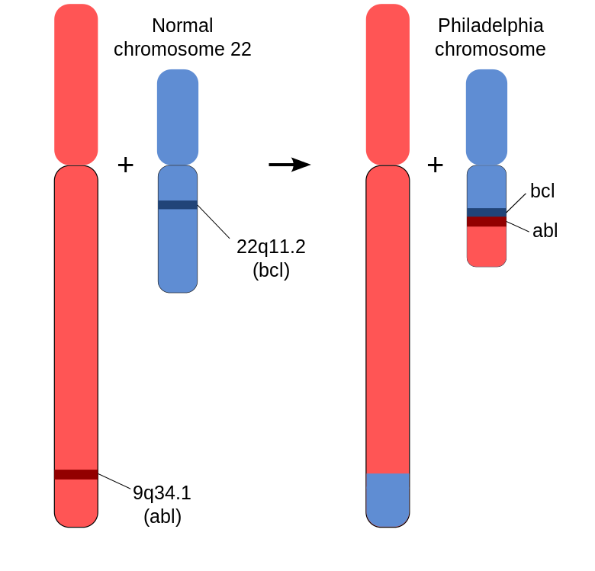
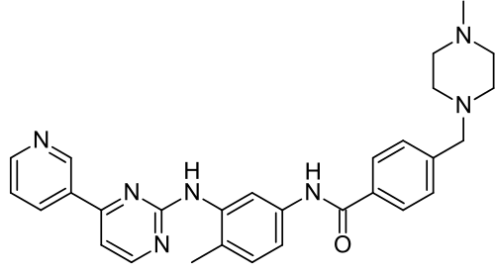
Detecting large chromosomal rearrangements
Chromosome translocation creates the new fusion protein bcr-abl – a permanently activated tyrosine kinase that causes cancer (chronic myelogenous leukemia).
Chr 9
Philadelphia chromosome
Chr 22
How would we see such a rearrangement in 2nd gen sequencing data?
Why might we miss it?
What type of sequencing data, or other data could we use to detect this rearrangement?
bcr
bcr-abl
fusion protein
abl
Gleevec (drug to treat chronic myelogenous )leukemia

